Slide 1


Slide 2
Automated Testing of XAML-Based Windows Phone Applications
DEV-B347
Vinay Krishna
Program Manager, Microsoft

Slide 3
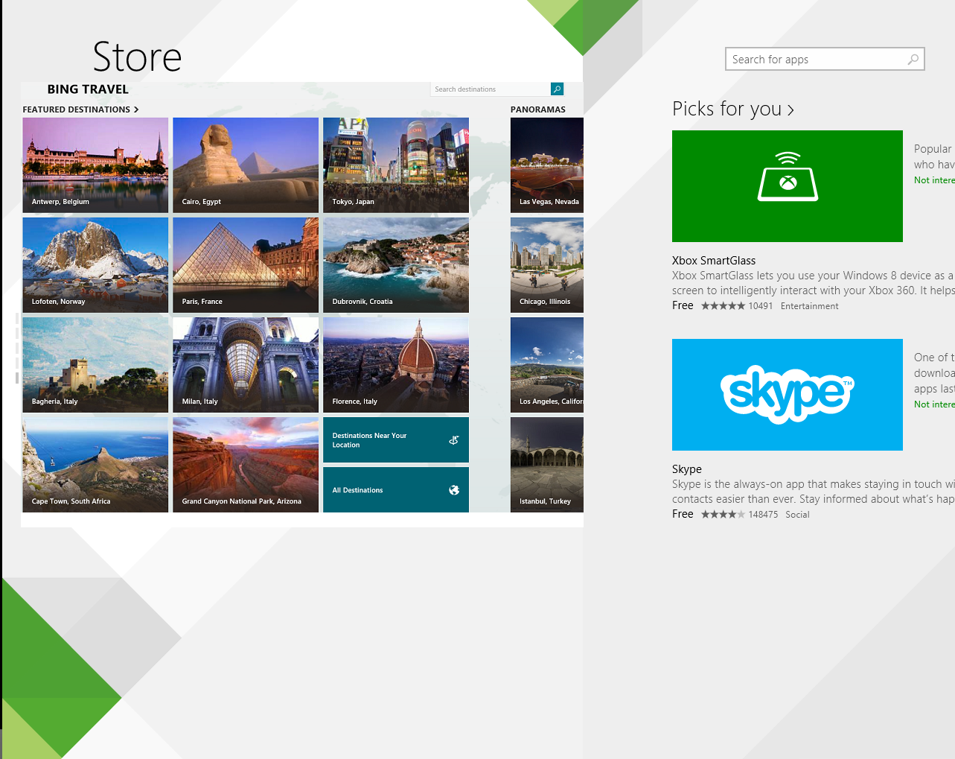
Agenda
Unit Test Framework for the XAML app developer
Automated end-user testing using Coded UI Test
Q&A

Slide 4
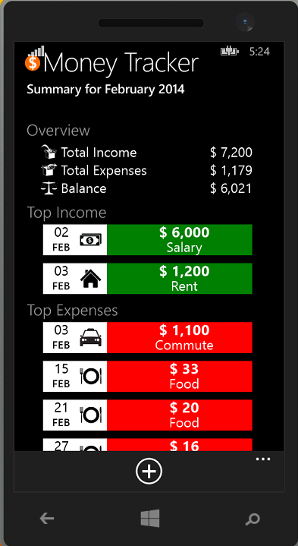
Quick Tour: Money Tracker App
Implements MVVM
Supports accessibility

Slide 5
Unit Test Framework: What Will You Need
Windows 8.1 or newer
Visual Studio 2013 Update 2 or newer
Express, Pro, Premium and Ultimate editions

Slide 6
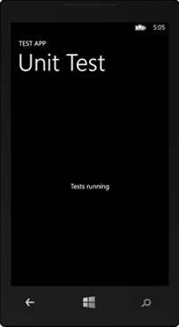
Unit Test Framework for App Developers
Author tests in C#/C++
Familiar MSTest Framework for test constructs
Tests run in the app context
Define capabilities in the app manifest

Slide 7
Demo
Unit Testing Windows Phone 8.1 XAML Apps

Slide 8
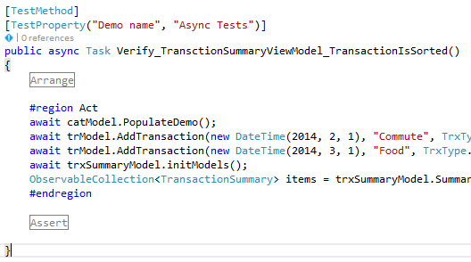
Demo: Testing the Ubiquitous Async Methods

Slide 9
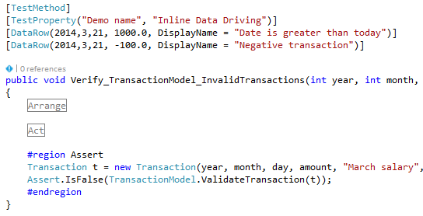
Demo: Inline Data-driving

Slide 10
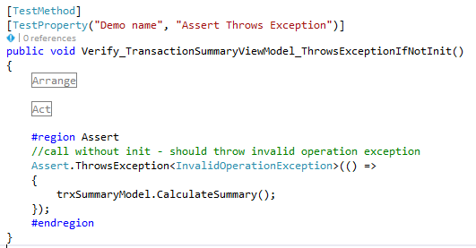
Demo: Assert on Exceptions

Slide 11
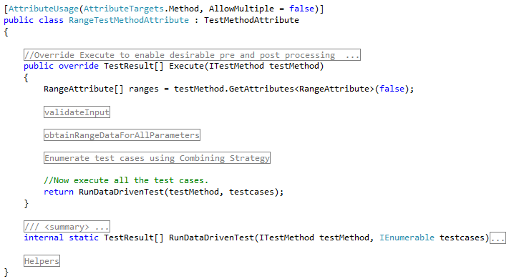
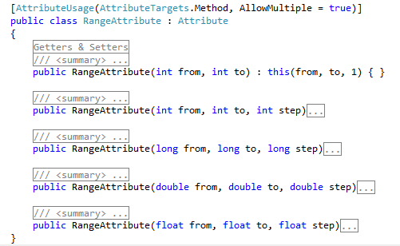
Demo: Extensible MSTest Framework

Slide 12
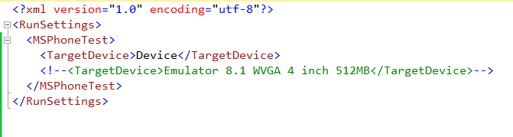
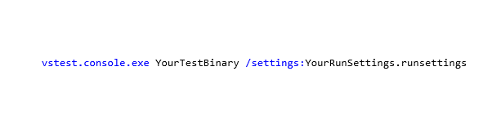
Demo: Execute from the Command-line

Slide 13
Coded UI Test: What Will You Need
Windows 8.1 or newer
Visual Studio 2013 Update 2 or newer
Premium and Ultimate editions
C# or VB.NET skills

Slide 14
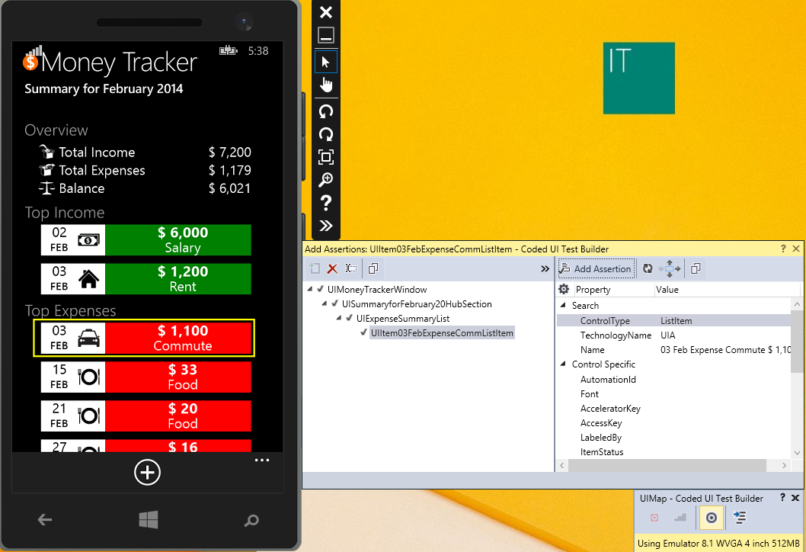
Unit Test Framework for App Developers
Project template for phone!
Specialized classes for XAML controls
Support for shell controls
Support for touch gestures
Run tests on a phone device

Slide 15
Demo
UI Testing Windows Phone 8.1 XAML Apps

Slide 16
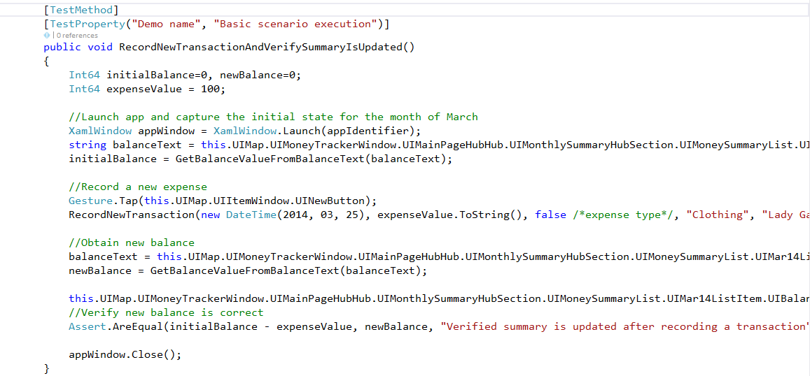
Demo: Let’s Automate “Add a Transaction”

Slide 17
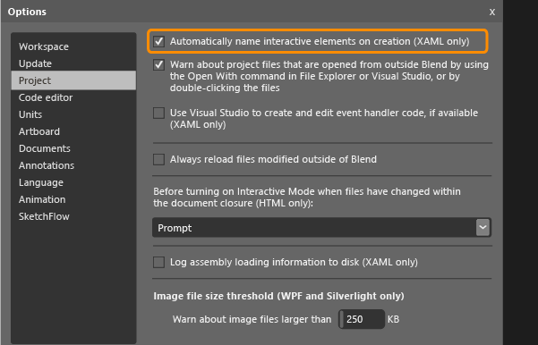
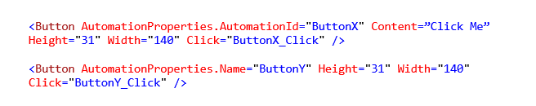
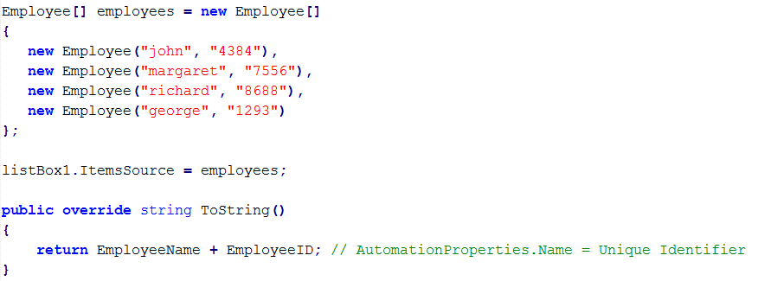
Demo: Let’s Automate “Add a Transaction”

Slide 18
Recap
Uniform developer experience for automated tests
Write unit tests using C#/C++
End-to-end functional testing using Coded UI Test
Run tests on a Windows Phone device

Slide 19

Related content
Breakout Sessions
DEV-B340 Building Beautiful Applications Using Blend and Visual Studio for XAML Applications
DEV-B333 Sharing Code and UI with Universal Projects and Windows Library for JavaScript (WinJS)
DEV-B350 Building Maintainable Windows Store Business Applications Using C#, XAML, and Prism
WIN-B210 The New Windows Phone Application Model
Find Me Later: MSE – Server Cloud Tools
Email: vikris@microsoft.com

Slide 20
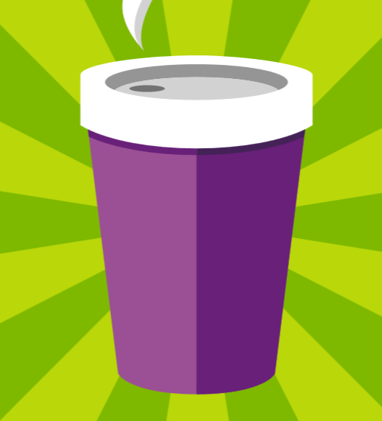


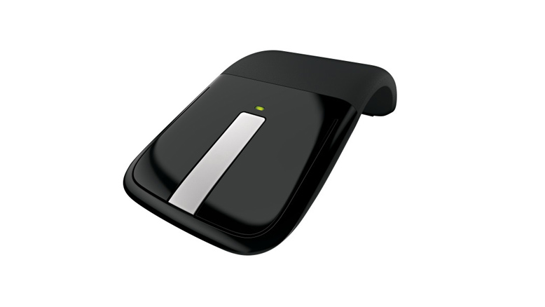
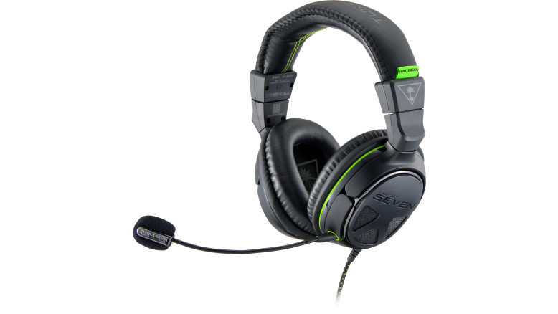


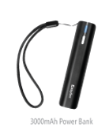
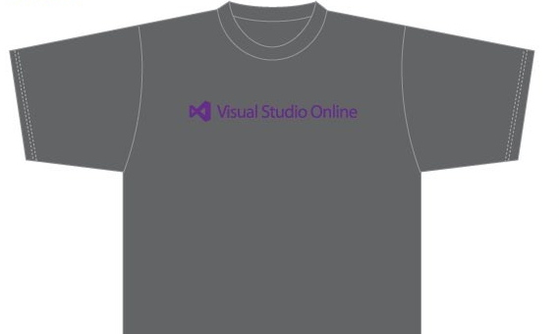
Visit the Developer Platform & Tools Booth
Having a friend buy your coffee?
Yea, it’s kind of like that.
MSDN Subscribers get up to $150/mo in Azure credits.
Stop by the Developer Platform and Tools booth and visit the MSDN Subscriptions station to activate your benefits and receive a gift!
http://aka.ms/msdn_teched
3 Steps to New Gear! With Application Insights
Create a Visual Studio Online account http://visualstudio.com
Install Application Insights Tools for Visual Studio Online http://aka.ms/aivsix
Come to our booth for a t-shirt and a chance to win!
VSIP QR Tag Contests
Visit our booth to join the hunt for cool prizes!

Slide 21


Resources
Microsoft Engineering Stories
Development tools & services for teams of all sizes
How Microsoft Builds Software
http://aka.ms/EngineeringStories
http://www.visualstudio.com
Visual Studio Industry Partner Program
Visual Studio | Integrate
Meet Our New Visual Studio Online Partners or Join Now.
http://vsipprogram.com
Create Your Own Dev Environment
http://integrate.visualstudio.com

Slide 22
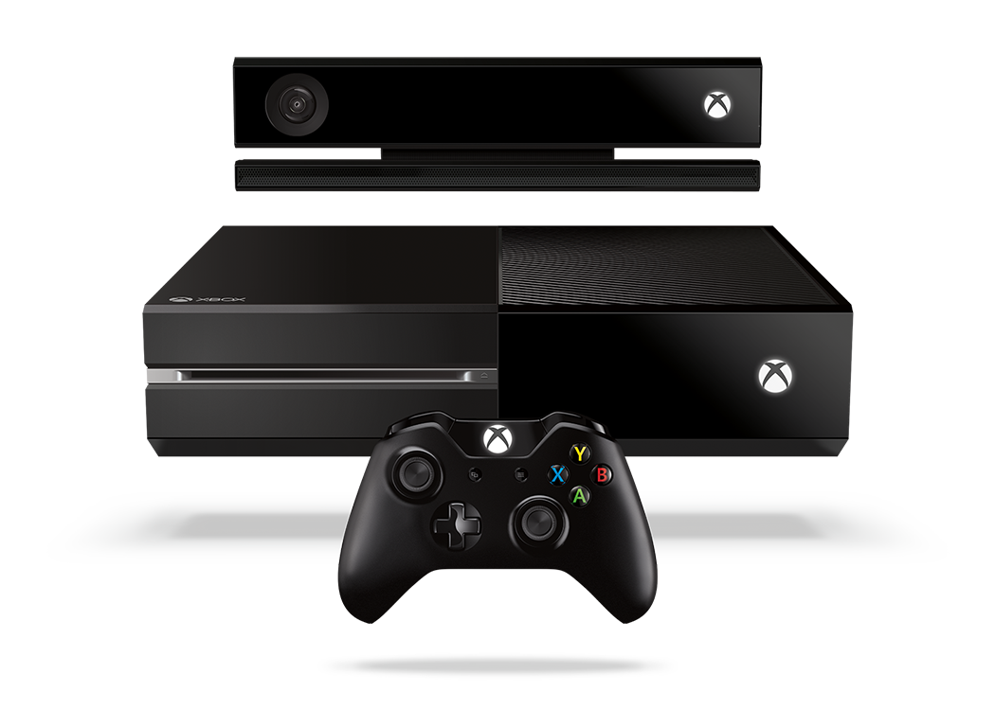


Complete an evaluation and enter to win!

Slide 23
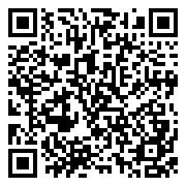
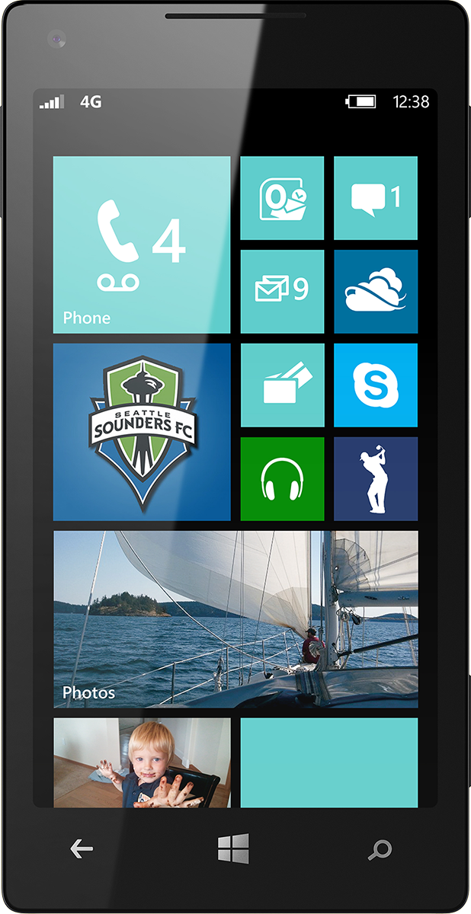
Evaluate this session
Scan this QR code to evaluate this session.

Slide 24


© 2014 Microsoft Corporation. All rights reserved. Microsoft, Windows, and other product names are or may be registered trademarks and/or trademarks in the U.S. and/or other countries.
The information herein is for informational purposes only and represents the current view of Microsoft Corporation as of the date of this presentation. Because Microsoft must respond to changing market conditions, it should not be interpreted to be a commitment on the part of Microsoft, and Microsoft cannot guarantee the accuracy of any information provided after the date of this presentation. MICROSOFT MAKES NO WARRANTIES, EXPRESS, IMPLIED OR STATUTORY, AS TO THE INFORMATION IN THIS PRESENTATION.

